Slide 2
BIBLE STUDY CLASS: The Seven Inseparable Links
of the Gospel
Central Valley Deaf Ministries - Fresno Central SDA Church
SS20260107_0214

Slide 3
Welcome

Slide 4
Opening Prayer

Slide 5
Tithes & Offerings

Slide 6
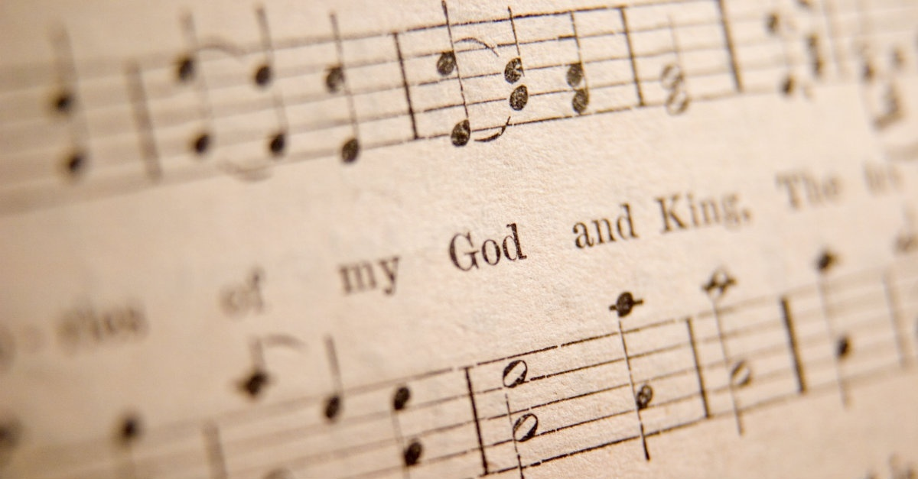
PRAISE GOD
Praise God from whom all blessings flow;
Praise Him, all people here below;
Praise Him above, your heavenly host;
Praise Father, Son, and Holy Ghost.

Slide 7
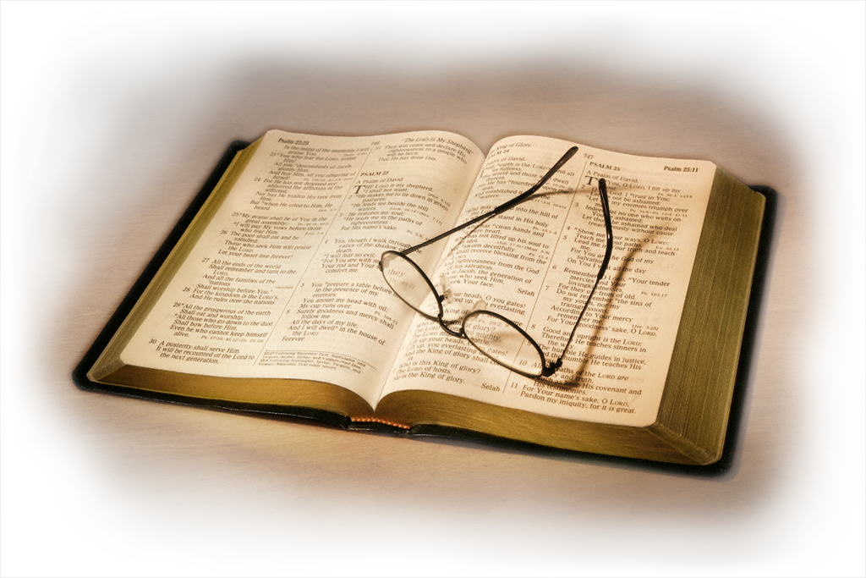
The Seven Inseparable Links of the Gospel
1
2
3
4
5
6
7

Slide 8
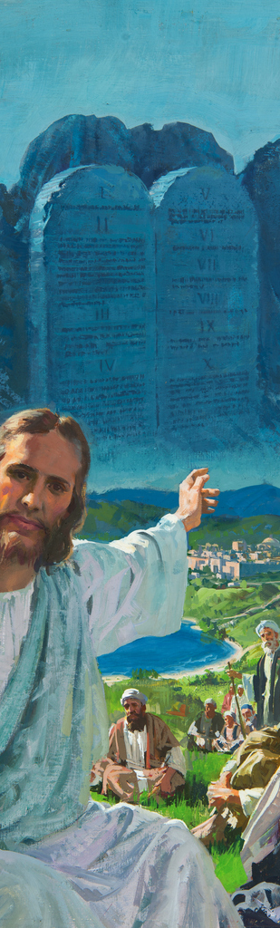
The Seven Inseparable Links of the Gospel
LAW
1
2
3
4
5
6
7
Romans 7:12

Slide 9
Romans 7:12 NKJV
“Therefore the law is holy, and
the commandment holy and just
and good.”

Slide 10
Psalm 119:160 NKJV
“All your words are true;
all your righteous laws are eternal.”

Slide 11
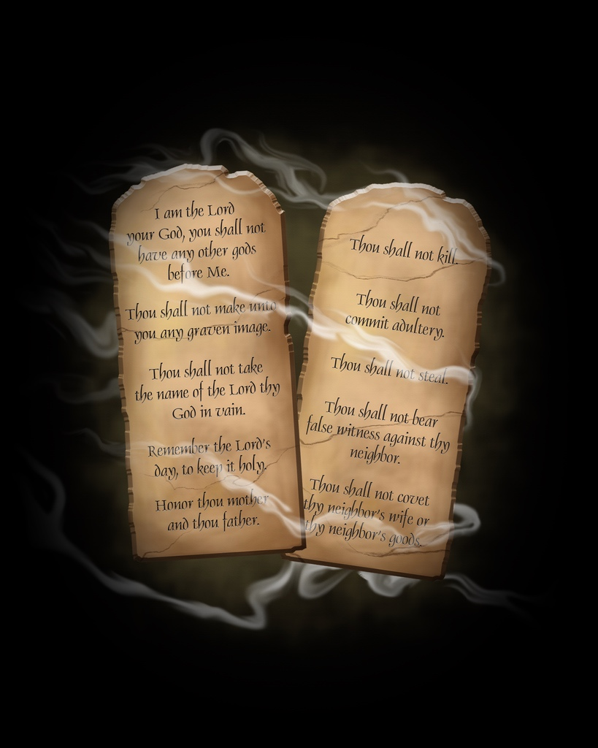
LAW
The law of God is seen as a reflection
of His character—timeless, perfect,
and unchanging, contrasting
with shifting human laws.
[imposed laws]

Slide 12
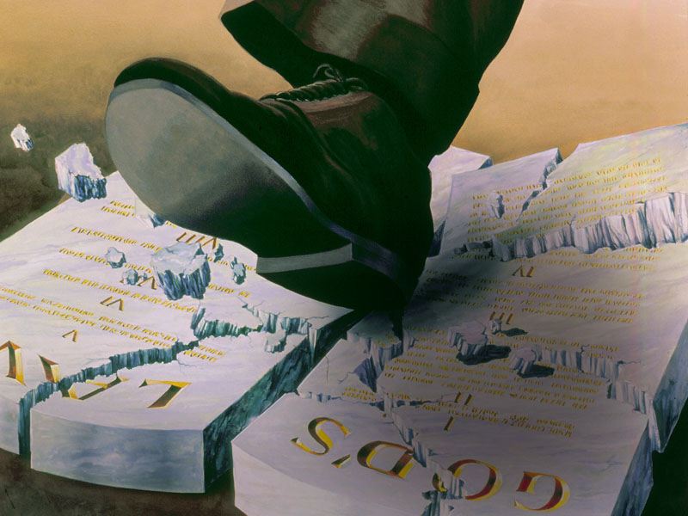
The Seven Inseparable Links of the Gospel
LAW
SIN
1
2
3
4
5
6
7
Romans 7:12
1 John 3:4

Slide 13
1 John 3:4 NIRV
Everyone who sins breaks the law.
In fact, breaking the law is sin.

Slide 14
Romans 14:23b NKJV
“ … for whatever is not from faith is sin.”
Meaning:
If we do not trust God that something is right, then it is a sin.

Slide 15
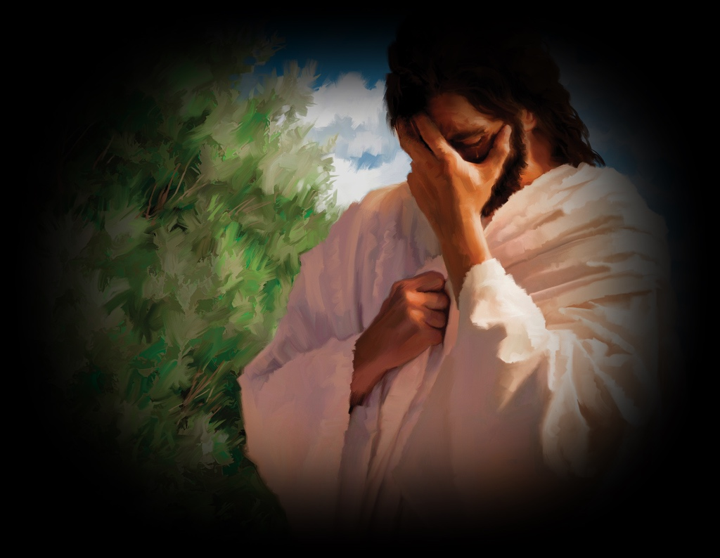
SIN
Sin, in summary, is acting in a way that goes against God’s way, His truth, and the life He gives.

Slide 16
The Seven Inseparable Links of the Gospel
LAW
SIN
DEATH
1
2
3
4
5
6
7
Romans 7:12
1 John 3:4
Romans 6:23

Slide 17
Romans 6:23
“For the wages of sin is death.”
Meaning:
What sin earns is second death.
[First death is sleep, usually dying by aging]

Slide 18
Genesis 2:16-17 NKJV
And the Lord God commanded the man, saying, “Of every tree of the garden you may freely eat; ¹⁷ but of the tree of the knowledge of good and evil you shall not eat, for in the day that you eat of it
you shall surely die.”

Slide 19
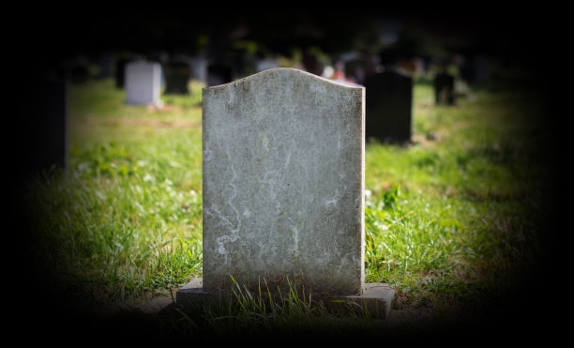
DEATH
The second death is the complete destruction of the wicked by God’s consuming fire.

Slide 20
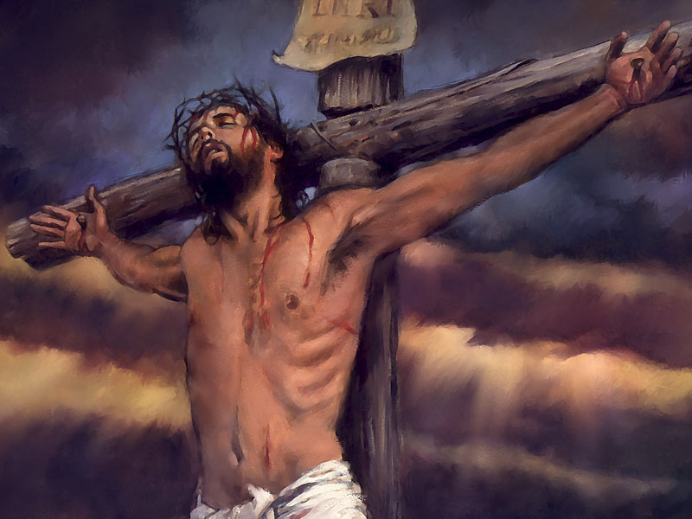
The Seven Inseparable Links of the Gospel
LAW
SIN
DEATH
GRACE
1
2
3
4
5
6
7
Ephesians
2:8-9
Romans 7:12
1 John 3:4
Romans 6:23

Slide 21
Ephesians 2:8-9 NKJV
For by grace you have been saved through faith, and that not of yourselves; it is the gift of God, not of works, …

Slide 22
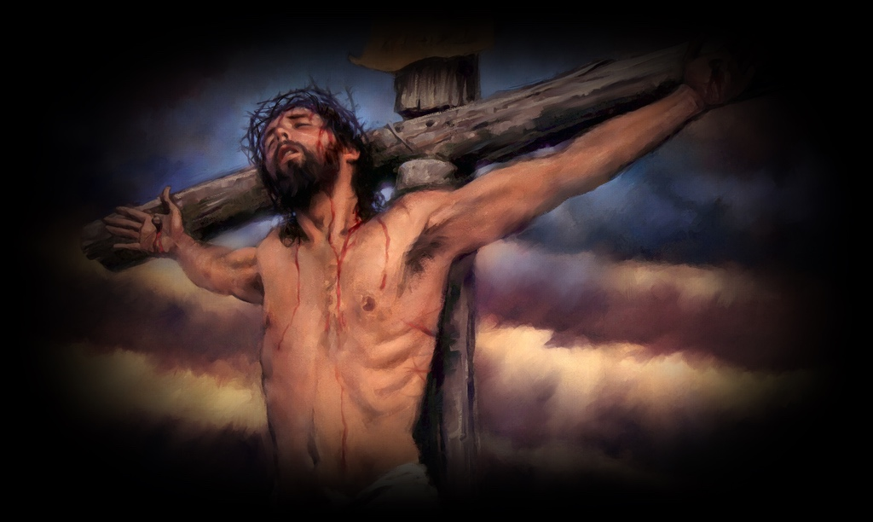
GRACE
It shows all the key parts of grace:
Grace saves — not our effort
Grace is a gift — not earned
Grace comes from God — not from us
Grace removes boasting — we cannot take credit
Grace here means: God doing for us
what we could never do for ourselves.

Slide 23
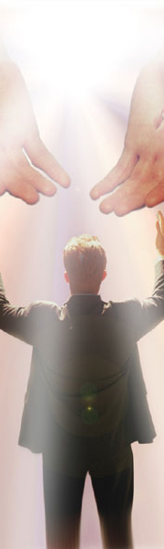
The Seven Inseparable Links of the Gospel
LAW
SIN
DEATH
GRACE
FAITH
1
2
3
4
5
6
7
Ephesians
2:8-9
Romans 7:12
1 John 3:4
Romans 6:23
Ephesians 2:8

Slide 24
Ephesians 2:8 NIV
For it is by grace you have been saved, through faith—and this is not from yourselves, it is the gift of God—

Slide 25
Proverbs 3:5
“Trust in the Lord with all your heart, and lean not on your own understanding.”
This is faith in daily action:
Trust God
Don’t rely only on what you see or
understand

Slide 26

FAITH
Faith is being fully convinced
that God will do what He says,
even when you cannot see how.

Slide 27
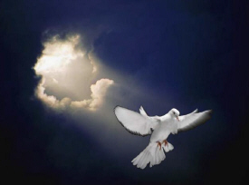
The Seven Inseparable Links of the Gospel
LAW
SIN
DEATH
GRACE
FAITH
WORK
1
2
3
4
5
6
7
Ephesians
2:8-9
Romans 7:12
1 John 3:4
Romans 6:23
Ephesians 2:8
James 2:26

Slide 28
Ephesians 2:10 NKJV
For we are His workmanship [His own master work], created in Christ Jesus [reborn from above—spiritually transformed, renewed, ready to be used] for good works, which God prepared [for us] beforehand that we should walk in them.

Slide 29
Hebrews 10:24 NCV
Let us think about each other and help each other to … do good deeds [works].

Slide 30
Romans 13:10 ESV
Love does no wrong to a neighbor; therefore love is the fulfilling of the law.

Slide 31
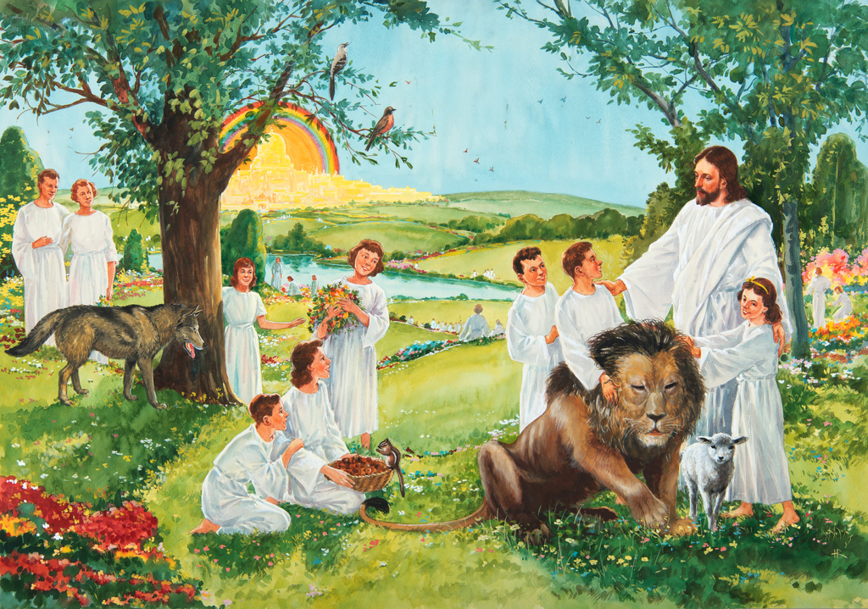
The Seven Inseparable Links of the Gospel
LAW
SIN
DEATH
GRACE
FAITH
WORK
REST
Ephesians
2:8-9
Romans 7:12
1 John 3:4
Romans 6:23
Ephesians 2:8
James 2:26
Hebrews 4:3

Slide 32
Hebrews 4:3 NIRV
Now we who have believed [that is, we who personally trust and confidently rely on God] enjoy that rest.

Slide 33
REST
We have His inner peace now
because we are confident in our salvation, and assured of His power.

Slide 35

LAW
REST
SIN
WORK
DEATH
FAITH
GRACE

Slide 36
The Seven Inseparable Links of the Gospel
LAW
SIN
DEATH
GRACE
FAITH
WORK
REST
Romans 7:12
1 John 3:4
Romans 6:23
Hebrews 2:9
Ephesians 2:8
James 2:26
Hebrews 4:3

Slide 37
Central Valley
Deaf Ministry Website
amazingknowledge.online

